Slide 1
Natural Disaster Help App
By
Briana Crockett, David Kay, Deep Patel

Slide 2
Our Idea
Create a mobile application that will give assistance to users caught in natural disasters such as tornadoes, hurricanes, and earthquakes.
Something beyond a “basic weather tracking app” by providing users with additional emergency services.
Give the average user and emergency services the important information such as locations of appropriate shelters, how to protect themselves during the storm, and emergency response dispatch.

Slide 3
Think Big!
Equipment for emergency personnel that uses the data from the app to rescue users.
A better close range phone locator to locate people buried after an earthquake
Equipment needed to support the app
Servers to store tracking data
Personnel needed to support the app
Manage/Update app as time progresses
Equipment to make this app available to those without sufficient technology
Worldwide access specifically targeting areas affected by natural disasters

Slide 4
What will it do?
Navigation System
Connect to a third-party navigation API such as Google Maps and Mapbox
Download navigation data for offline usage before disaster in case of disconnection from internet services
Navigate to safest location which vary based on disaster
Tracking System
User will be prompted to enable tracking before and during disaster
The application will alert the user if they are in the area of effect of a natural disaster
Server
Predict user location based on data collected from pings
Wellness Check
Tries to determine a user’s condition after a disaster
Deploys a pop-up that will determine if emergency response is dispatched to the location.

Slide 5
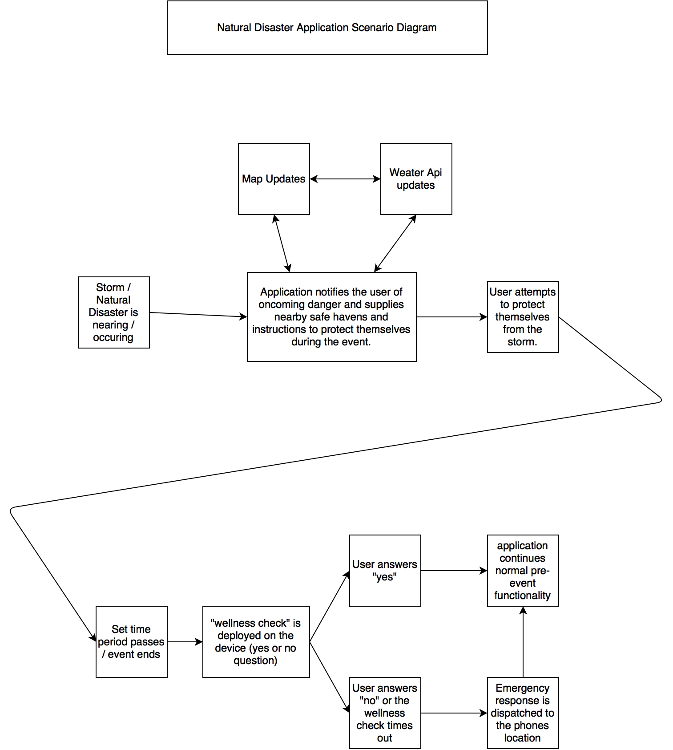

Slide 6
Current Products
Provide nothing more than a weather tracker
With the current “emergency apps” you are fortunate to get at most a working weather tracker
Fail when internet services are unavailable
Most of these apps give the user nothing but an error screen when there is no internet access
Scams
Quite a number of these supposed “help apps” are just scams apps that just display picture or nothing but still cost money.

